Slide 1
Virtual Functions
and
Pure Virtual Function

Slide 2
Runtime Polymorphism
Definition
Ability to take more than one form
An essential feature of an OO Language
It builds upon Inheritance
Allows run-time interpretation of object type for a given class hierarchy
Also Known as “Late Binding”
Implemented in C++ using virtual functions
Notes:
2

Slide 3
Dynamic Binding
Is the run-time determination of which function to call for a particular object of a derived class based on the type of the argument
Declaring a member function to be virtual instructs the compiler to generate code that guarantees dynamic binding
Dynamic binding requires pass-by-reference
Notes:
3

Slide 4
The essential requirement of the polymorphism is therefore the ability to refer to objects without any regard to their classes.
With the use of single pointer variable, we may refer to the objects of different classes.
When we use the same function name in both the base and the derived class, the function in base class should be declared as virtual.
To determine which function to use at run time based on the type of object pointed to by the base pointer, rather than the type of the pointer.
Thus, by making the base pointer to point to different objects, we can execute different versions of the virtual function

Slide 5
Whether constructors and destructors can be virtual??
Virtual constructors not allowed
But virtual destructors are allowed
when a constructor of a class is executed, there is no virtual table in the memory, means no virtual pointer defined yet.
To do dynamic binding make destructors as virtual

Slide 6
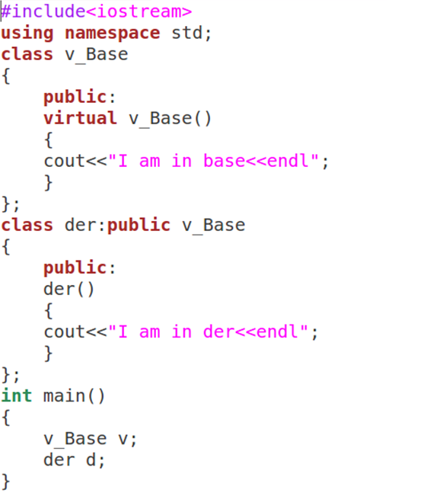

Slide 7
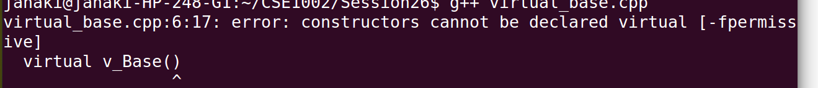

Slide 8
Program illustrates how a base class pointer is used to access a derived class

Slide 9
#include<opstrea,.h>
class base
{
int x;
public:
void setx( int i) { x=i; }
int getx() { return x;}
};
class derived: public base
{
int y;
public :
void sety( int i) { y=i; }
int gety() { return y; }
};
void main()
{
base *p;
base bob;
derived dob;
p=&bob;
p->setx(54);
cout<<“ Base Obj x :”<<p->getx()<<“\n”;
p=&dob;
p->setx(89);
dob.sety(65);
cout<< “ Derived Obj x: “<<p->getx()<<“\n”;
cout<< “ Derived Obj y: “<<dob.gety()<<“\n”;
}
Output :
Base Obj x : 54
Derived Obj x : 89
Derived Obj y : 65

Slide 10
Program illustrate the use of Virtual Function and Overridding
#include<iostream.h>
Class base
{
public :
int i;
base (int x) { i=x; }
virtual void func()
{
cout<<“ Base class func() “<<i<<“\n”;
}
};
Class der1: public base
{
public :
der1(int x) : base(x) { }
void func()
{
cout<<“ Derived class1 func() “<<i*i<<“\n”;
}
};
Class der2: public base
{
public :
der2(int x) : base(x) { }
void func()
{
cout<<“ Derived class2 func() “<<i+i<<“\n”;
}
};
Void main()
{
base *p;
base bob(10);
der1 dob1(10);
der2 dob2(10);
p=&bob;
P->func();
p=&dob1;
P->func();
p=&dob2;
P->func();
}
Output :
Base class fun() : 10
Derived class1 fun() : 100
Derived class2 fun() : 20

Slide 11
Program illustrate how appropriate version of a Virtual Function is fixed at run time
#include<iostream.h>
#include <stdlib.h>
#include <iomanip.h>
Class base
{
public :
int i;
base (int x) { i=x; }
virtual void func()
{
cout<<“ Base class func() “<<i<<“\n”;
}
};
Class der1: public base
{
public :
der1(int x) : base(x) { }
void func()
{
cout<<“ Derived class1 func() “<<i*i<<“\n”;
}
};base
Class der2: public base
{
public :
der2(int x) : base(x) { }
void func()
{
cout<<“ Derived class2 func() “<<i+i<<“\n”;
}
};
void main()
{ int i,j;
base *p;
der1 dob1(10);
der2 dob2(10);
for(i=0; i<4; i++)
{
j=rand()/7;
cout<<setw(10)<<j<<“ “;
if(j%2)
p=&dob1;
else
p=&dob2;
p->func();
}
}

Slide 12
Output :
49 Derived class1 func() : 100
18 Derived class2 func() : 20
1568 Derived class2 func() : 20
155 Derived class1 func() : 100

Slide 13
Program illustrate Inheritance of virtual functions
Class der2: public der1
{ int x;
public :
void initx()
{
x=15;
cout<<“ The value of x : “<<x<<“\n”;
}
};
void main()
{ base *p;;
base bob;
der1 dob1;
der2 dob2;
p=&bob;
P->func();
p=&dob1;
P->func();
p=&dob2;
P->func();
// P->initx(); Error as initx() not a member of base class
dob2.initx(); //initx() as member of dob2
}
#include<iostream.h>
class base
{
public :
int i;
base (int x) { i=x; }
virtual void func()
{
cout<<“ Base class func() :\n”;
}
};
Class der1: public base
{
public :
der1(int x) : base(x) { }
void func()
{
cout<<“ Derived class1 func() :\n”;
}
};

Slide 14
Output :
Base class func() :
Der1 class func() :
Der1 class func() :
The Value of X : 15

Slide 15
Pure Virtual Function
Sometimes the virtual function declared in the base class may not have meaningful operation to perform.
In that situation, base class supplies only the prototype of the virtual function, and the implication is the derived class must override this function.
A virtual function is said to be Pure Virtual Function when it has no definition relative to the base class. Only the function’s prototype is included in the base class.
This forces every derived class to override it.
To create a Pure Virtual function, The general form is “
virtual return type function name (arg-list ) =0;

Slide 16
The pure specifier
The "= 0" portion of a pure virtual function is also known as the pure specifier, because it’s what makes a pure virtual function “pure”.
Pure specifier appended to the end of the virtual function definition may look like the function is being assigned a value of 0, that is not true.
The notation "= 0" is just there to indicate that the virtual function is a pure virtual function, and that the function has no body or definition.
16

Slide 17
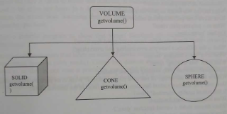
#include<iostream.h>
#include<conio.h>
Class volume
{
double dim1,dim2,dim3;
public :
void setdim(double d1, double d2=0,double d3=0)
{
dim1=d1; dim2=d2; dim3=d3;
}
void getdim(double &d1, double &d2,double &d3)
{
d1=dim1; d2=dim2; d2=dim3;
}
virtual double getvolume()=0;
};
Class solid : public volume
{
public :
double getvolume()
{
double d1,d2,d3;
getdim(d1,d2,d3);
return (d1 *d2*d3);
};
Class cone : public volume
{
public :
double getvolume()
{
double d1,d2,d3;
getdim(d1,d2,d3);
return ((1.0/3.0)*(22.0/7.0)*(d1 *d2*d3));
};
Class sphere : public volume
{
public :
double getvolume()
{
double d1,d2,d3;
getdim(d1,d2,d3);
return ((4.0/3.0)*(22.0/7.0)*(d1 *d2*d3));
};

Slide 18
Output :
Volume of solid : 40
Volume of cone : 83.809524
Volume of sphere : 268.190476
Void main()
{
volume *p;
solid s;
cone c;
sphere sp;
s.setdim(4.0,5.0,2.0);
c.setdim(4.0,5.0);
sp=setdim(4.0);
p=&s;
cout << “volume of solid : “<<p->getvolume()<<“\n”;
p=&c;
cout << “volume of cone : “<<p->getvolume()<<“\n”;
p=&sp;
cout << “volume of sphere: “<<p->getvolume()<<“\n”;
};

Slide 19
Pure Virtual Functions: Summary
Pure virtual functions are useful because they make explicit the abstractness of a class
Tell both the user and the compiler how it was intended to be used
Note : It is a good idea to keep the common code as close as possible to the root of your hierarchy
19
Notes:
19

Slide 20
Abstract Classes
A class with one or more pure virtual functions is an Abstract Class
Objects of abstract class can’t be created
Abstract Class is a class which contains at least one Pure Virtual function in it.
Abstract classes are used to provide an Interface for its sub classes.
Classes inheriting an Abstract Class must provide definition to the pure virtual function, otherwise they will also become abstract class.
But pointer of abstract class can hold address of derived class

Slide 21
Difference b/w Virtual and Pure Virtual Function
A pure virtual function makes the class it is defined for abstract.
Abstract classes cannot be instantiated.
Derived classes need to override/implement all inherited pure virtual functions.
If they do not, they too will become abstract. In C++, a class can define a pure virtual function that has an implementation.

Slide 22
Rules for Virtual Functions
Virtual function must be a class member
Virtual function cannot be static member
The keyword virtual is used only in the base class
The virtual function and its derived class should have the same type and number of arguments and same return type.
Constructors cannot be virtual
There can be virtual destructors

Slide 23
Virtual function in the base class must be defined even if it may not be used.
A virtual function can be a friend of another class.
Virtual functions are hierarchical
Virtual functions are accessed using pointers to objects.
A base pointer can point toa derived object, but the reverse is not true.
A virtual function defined in base neednot necessarily redefined in the derived class, in that case, a call will invoke base function

Slide 24
Example: Pure Virtual Functions
class A {
public:
virtual void x() = 0;
virtual void y() = 0;
};
class B : public A {
public:
virtual void x();
};
class C : public B {
public:
virtual void y();
};
int main () {
A * ap = new C;
ap->x ();
ap->y ();
delete ap;
return 0;
};
A is an abstract (base) class
Similar to an interface in Java
Declares pure virtual functions (=0)
May also have non-virtual methods, as well as virtual methods that are not pure virtual
Derived classes override pure virtual methods
B overrides x(), C overrides y()
Can’t instantiate an abstract class
class that declares pure virtual functions
or inherits ones that are not overridden
A and B are abstract, can create a C
Can still have a pointer or reference to an abstract class type
Useful for polymorphism
24

Slide 25
Practice Problem:
Different types of employees based on the way in which salary is calculated
All employees has salary but that cannot be determined in base class
Force any derived class to implement it
Make it as pure virtual functions

Slide 26
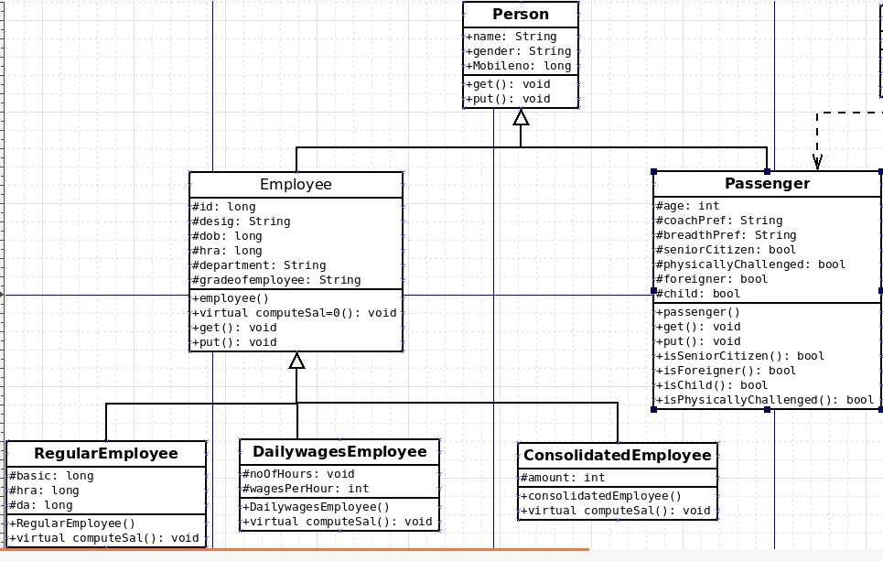

Slide 27
Additional Problems

Slide 28
Simple Example
Math Symbol Problem
Create an abstract class MathSymbol may provide a pure virtual function doOperation(), and create two more classes Plus and Minus implement doOperation() to provide concrete implementations of addition in Plus class and subtraction in Minus class.

Slide 29
Algorithm for Math Symbol Problem
Create Mathsymbol abstract class with doOperation() pure virtual function.
Create plus class derived from Mathsymbol.
Create minus class dervied from Mathsymbol.
Perform addition in plus class using doOperation() pure virtual function.
Perform subtraction in minus class using doOperation() pure virtual function.
Print each values in respective classes.
29

Slide 30
Implementation in C++
Already learnt creating classes
Learnt about Inheritance
Define Pure virtual function in Abstract(base) class.
Inherit virtual function for distinct operations.
Already learnt about how to display the output.
30

Slide 31
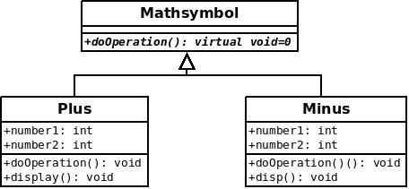
Class Diagram using Dia

Slide 32
Example
Some classes exist logically but not physically.
Example : Mathsymbol
Mathsymbol M;
Mathssymbol makes sense only as a base of some classes derived from it. Serves as a “category”
Hence instantiation of such a class must be prevented
class Mathsymbol //Abstract
{ public : //Pure virtual Function virtual void doOperation() = 0;
}
Mathsymbol M; // error : variable of an abstract class
Notes:
32

Slide 33
A pure virtual function not defined in the derived class remains a pure virtual function.
Hence derived class also becomes abstract
class Plus : public Mathsymbol{ //No doOperation() - Abstract public : void print(){ cout << “Doing Addition” << endl; }
class Minus : public Mathsymbol { public : void doOperation(){ // Override Mathsymbol:: doOperation() int a=10,b=5;
cout << “Subtration is = ” <<a-b<< endl; }
Minus m; // Valid
Plus p; // error : variable of an abstract class
Notes:
33

Slide 34
It is still possible to provide definition of a pure virtual function in the base class
The class still remains abstract and functions must be redefined in the derived classes, but a common piece of code can be kept there to facilitate reuse
In this case, they can not be declared inline
class Mathsymbol { //Abstract public : virtual void doOperation() = 0;
}; // OK, not defined inline
void Mathsymbol::doOperation(){ cout << “Arithmetic" << endl; }
class Minus : public Mathsymbol
{ public : void doOperation(){ Mathsymbol::doOperation(); //Reuse cout <<“Subtraction”<< endl; }
34
Notes:
34

